Slide 1
https://www.nextplatform.com/2020/01/27/european-processor-initiative-readies-prototype/

Slide 2
Lecture 5
Resource Management
Symmetric Multiprocessors

Slide 3
Resource Management

Slide 4
Need for Resource Management
Protecting significant infrastructure investment
Supercomputing hardware
Hosting data center
Power delivery (cabling, UPSs, generators, flywheels)
Cooling infrastructure (HVAC units, heat exchangers, pipes for water cooling, etc.)
Cost of ownership
Electricity (about $1M/1MW per year)
Support contracts
Maintenance crew (system administrators, technicians)
Getting the most for your $
Efficient workload scheduling
Maximizing hardware resource utilization
Compute job prioritization

Slide 5
Types of Managed Resources
Compute nodes
Processing cores
Interconnect
Permanent storage and I/O
Accelerators

Slide 6
Compute Nodes
Each node provides a fixed compute and storage footprint
Constitutes a fundamental resource allocation unit for a compute job
Increasing the number of nodes enables straightforward application scaling
Resources may vary depending on node type
CPU type and clock frequency
Main memory capacity
Interconnect bandwidth and latency
Optionally: secondary storage speed and capacity

Slide 7
Processing Cores
Provide local parallelism:
Multiple cores per processor
Possibly multiple processors (sockets) per node
Sharing of processing elements between different applications:
Depends on application type and usage context
Single compute core is a typical allocation unit
Shared mode enables better resource utilization
Parameter space sweeps
Large number of unrelated small jobs
Exclusive mode allocates full node to a single application
Benchmarking (minimizes intrusions from unrelated jobs)
Applications that demand large memory capacity
Applications generating large number of I/O requests to local storage
Bandwidth-intensive distributed jobs
Affinity to other hardware components of the node (e.g., PCI-Express)

Slide 8
Interconnect
Typically one type per system
10G Ethernet
InfiniBand
1G Ethernet (GigE)
Installations with multiple networks possible
To permit experiments with different bandwidth and latency profiles
To accommodate bandwidth-insensitive applications along with network “hogs”
To enable high-performance mechanisms available in certain implementations (such as RDMA)
To utilize channel bonding for increased communication bandwidth
Notes:
RDMA – Remote direct memory access – basically it allows memory over a network to be passed around without involving CPUs

Slide 9
Permanent Storage
Typically implemented as a shared file system
Exported system-wide, thus accessible from every node
High capacity to accommodate all users
Optimized for performance and reliability (e.g., RAID)
Multiple file systems may be provided for different usage scenarios
Users’ home directories, often quota-limited
Scratch space for larger data volumes, but with limited retention (e.g. automatic deletion after one week of last access)
Archive storage with very large capacity, long term retention, but potentially limited access bandwidth
Local file systems
Localized storage may provide better aggregate data bandwidth
Example 1: disk drives in each node
Example 2: burst buffers in Cray machines (SSD pools shared by groups of nodes)
But: limited data access options (the user must log into the same machine or group of nodes where dataset was saved)

Slide 10
Accelerators
Special purpose processors
Heterogeneous (different hardware class to main CPU)
May be application specific
Expose large number of fine-grain processing elements
Consume less energy and time to accomplish certain tasks compared to the host processor
Use different compilers and libraries to generate executables
Knowledge of internal organization usually a must to develop efficient applications
Often require explicit code and data offload to processing unit
Commonly used variants
General Purpose Graphics Processing Unit (GPGPU)
Intel Xeon Phi
Field Programmable Gate Array (FPGA)
System hardware may not be uniformly populated with accelerators
Some nodes may be equipped with several accelerators while the others contain none
Resource managers should support allocation of accelerated nodes when required by application

Slide 11
Compute Job
A self-contained work unit that may need specific input data and produces a result in the course of its execution (output)
Input may be typed by the user or a file
Output could be a file, a printout on the console or graphics displayed on screen
Primary modes of job processing
Interactive: requires interaction with user
Batch: resource requirements, job description, and inputs are fully specified at job submission time
Batch processing accounts for most of machine’s computational throughput
May be subdivided into smaller steps or tasks
Data staging
Data pre- and post-processing
Visualization
Processing application pipelines

Slide 12
Job Queue
Defines order in which jobs are executed on the machine
Typically FIFO (“first-in, first-out”)
Job schedulers may deviate from the prearranged order to improve utilization/throughput or due to operator’s override
Groups jobs targeting the same set of resources
Most systems have multiple job queues, for example
Production
Job size
Job duration
Debug
Interactive
Managing specific resources, such as large memory nodes or accelerators

Slide 13
Job Scheduling
Critical to achieving good utilization of the machine
Must accommodate potentially hundreds or thousands of waiting jobs and a significant number of concurrently executing jobs
Parameters affecting job scheduling
Resource availability
Job priority
Resources allocated to the user
Maximum number of jobs
Requested execution time
Elapsed execution time
Job dependencies and prerequisites
Occurrence of specified events
Operator availability
Software license availability

Slide 14
Common Resource Managers
Simple Linux Utility for Resource Management (Slurm)
Portable Batch System (PBS)
OpenLava based on the Load Sharing Facility (LFS)
Moab Cluster Suite
Tivoli Workload Scheduler LoadLeveler
Univa Grid Engine
HTCondor
OAR
Hadoop Yet Another Resource Negotiator (YARN)

Slide 15
SHARCNET currently uses Platform's LSF scheduler with some local additions. LSF uses the concept of user "shares" to allocate system resources to user jobs so as to provide fair access in a shared environment.
I’m not yet sure which it uses, but Platform itself was acquired by IBM in 2012 and they have “Spectrum LSF” but the open version of LSF became OpenLava in 2011, those seem like two separate products.
Not that it really matters.

Slide 16
Slurm Introduction
One of the most popular open-source managers
Originated in early 2000s at Lawrence Livermore National Laboratory (Morris Jette)
Currently close to 200 contributors (such as SchedMD LLC, HP, Bull, Cray, ORNL, LANL, Intel, Nvidia, and others)
Utilized in about 60% of machines in the TOP500 list (mid-2014)

Slide 17
Slurm Features
Complex configuration options
Different interconnect types
Scheduling algorithms
MPI implementations
Job accounting
Scalable to over 10 million cores (TaihuLight)
Manages up to a thousand job submissions and 500 job executions per second
Multiple strategies for power optimization
Increased reliability through multiple daemons
Network topology aware
Decisions influenced by node architecture (NUMA, core distribution, thread affinities)
Supports expanding and shrinking job’s resource footprint during its execution
A number of scheduling algorithms with a broad range of control parameters
Accelerator support
Extensible via plugins in C and Lua
Optional support for job profile database

Slide 18
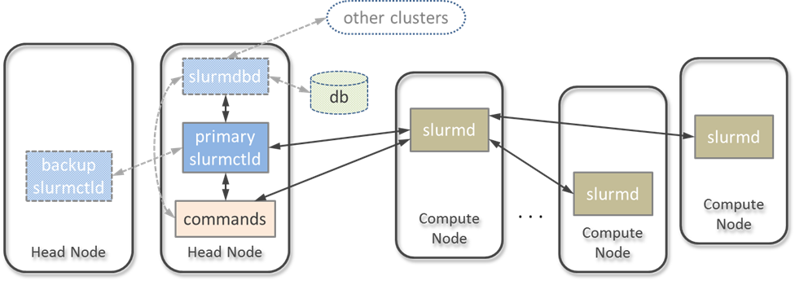
Slurm Architecture

Slide 19
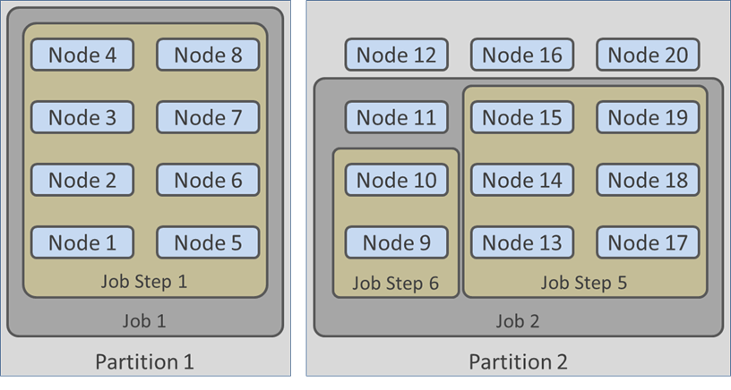
Workload Organization
Partitions (queues)
Group execution resources
Uniquely named
May overlap
Job steps may utilize all or a fraction of nodes allocated to a parent job
Job arrays are a means to manage a large number of similar jobs (e.g., for throughput computing)

Slide 20
Slurm Scheduling
Event-triggered scheduling as default
Considers only a limited number of jobs at the head of the queue
Fast and low overhead
Backfill scheduler
Starts lower priority jobs if that will not affect the expected start time of higher priority jobs
Fair treatment of lower priority jobs that require large amount of resources
Improves overall utilization
Gang scheduling
For multiple similar jobs sharing the same set of resources
Preemption
Stopping lower priority jobs to launch higher priority jobs
Generic Resources (GRES) driven scheduling
Based on hardware device availability (e.g., accelerators)
Elastic computing
Permits growing or shrinking of the overall resource footprint (both provided by the system or requested by the job)
High throughput computing

Slide 21
srun
Starts a parallel job or job steps
Performs resource allocation for the job if such has not been performed yet
Syntax: srun [<options>] <executable> [<arguments>]
Frequently used options:
-t or --time=<[hours:]minutes:seconds>
-p or --partition=<name>
-N or --nodes=<min_nodes>
-n or --ntasks=<number_of_tasks>
-c or --cpus-per_task=<number_of_cpus>
--mem=<megabytes>
--exclusive
-s or --oversubscribe

Slide 22
salloc
Performs resource allocation and runs the command specified by the user
Accepts the same options as srun
Syntax: salloc [<options>] [<command> [<arguments>]]

Slide 23
sbatch
Submits a job script for batch processing
Exits as soon as job parameters are accepted by the controller daemon (it does not wait for job execution)
Job output is stored in file named “slurm-%j.out”, where %j is the job number
Syntax: sbatch [<options>] [<script> [<arguments>]]
Uses the same resource options as srun

Slide 24
Example MPI+OpenMP Job Script
#!/bin/bash
#SBATCH --nodes=16
#SBATCH --cpus-per-task=8
#SBATCH time=2:00:00
# The hello_world application will be started
# on 16 nodes with 8 threads per process;
# its execution time is limited to 2 hours
export OMP_NUM_THREADS=$SLURM_CPUS_PER_TASK
mpirun hello_world

Slide 25
squeue
Displays information about queued jobs
May be used to examine the job’s status as well as resource allocations
Syntax: squeue [<options>]
Frequently used options:
--all
-l or --long
-M or --clusters=<list_of_clusters>
-p or --partition=<name>
-t or --states=<list_of_states>
-u or --user=<list_of_users>
-i or --iterate=<seconds>
Common job states include (abbreviated form in parentheses): PENDING (PD), RUNNING (R), SUSPENDED (S), STOPPED (ST), COMPLETING (CG), CANCELLED (CA), FAILED (F), TIMEOUT (TO), PREEMPTED (PR)

Slide 26
scancel
Used to cancel submitted jobs or deliver signals to them
Syntax: scancel [<options>] [<jobid>]…
Frequently used options:
-s or --signal=<signal_name>
-n or --name=<job_name>
-p or --partition=<partition_name>
-t or --state=<job_state>
-u or --user=<user_id>
-i or --interactive
The permitted job state include PENDING, RUNNING or SUSPENDED

Slide 27
sacct
Retrieves job information from Slurm logs
May be used to access status and exit code of no longer existing jobs
Syntax: sacct [<options>]
Frequently used options:
-a or allusers
-L or allclusters
-l or long
-j or job=<job_id>
--name=<list_of_job_names>
-s or state_list=<list_of_states>
The permitted states are same as for the squeue command

Slide 28
sinfo
Displays system’s partition and node information
Syntax: sinfo [<options>]
Frequently used options:
squeue’s options: all, long, clusters partition, iterate have the same meaning here
-r or --responding
-d or --dead
-e or --exact
-N or --Node

Slide 29
Important Environment Variables
Accessible from within job scripts
Permit runtime customization of job execution
Often used variable list
SLURM_NTASKS
SLURM_NTASKS_PER_NODE
SLURM_CPUS_PER_TASK
SLURM_JOB_NUM_NODES (total number of nodes allocated to job)
SLURM_CPUS_ON_NODE (number of cores on the current node)
SLURM_SUBMIT_HOST
SLURM_CLUSTER_NAME
SLURM_JOB_PARTITION
SLURM_JOB_ID
SLURM_JOB_NODELIST (list of node names allocated to the job)
SLURM_TASKS_PER_NODE (list of tasks on each node corresponding to the host order in SLURM_JOB_NODELIST)
SLURM_SUBMIT_DIR

Slide 30
Slurm Tips and Tricks
Launch interactive shell:
srun -N2 -t60 --pty /bin/bash
Enable X window forwarding:
srun -N1 -t20 --x11 xterm
Figure out the estimated start time of queued job:
squeue --start -j <job_id>
Email notification when job terminates or fails:
sbatch --mail-type=END,FAIL myjobscript

Slide 31
PBS Overview
Started as a contract for NASA Ames developed by MRJ Technology Solutions in 1991
Based on POSIX 1003.2d standard
Includes contributions from NASA Ames, LLNL, NERSC
Commercial version (PBS Pro) released by Veridian Corp. in 2000
IP acquired by Altair Engineering (current owner)
Open sourced in 2016
Capable of grid workload execution using Globus toolkit
Supports advanced reservation, ability to dynamically add and remove execution nodes, topology-aware scheduling, GPUs
Used by many commercial and academic institutions as well as national laboratories
Other, mostly compatible, implementations include:
OpenPBS (no longer maintained)
TORQUE (Terascale Open-source Resource and QUEue manager) developed by Adaptive Computing
Notes:
Portable batch system

Slide 32
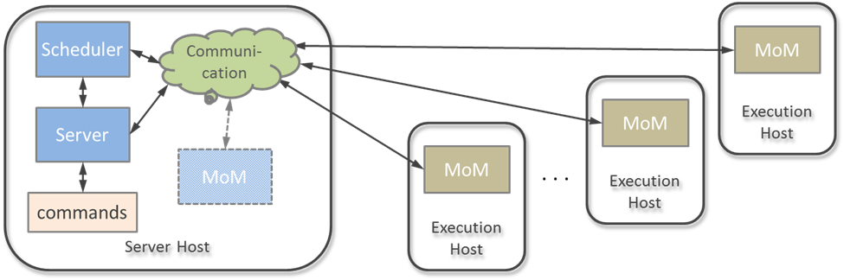
PBS Architecture
Server daemon processes user commands and creates, monitors, and dispatches jobs
Scheduler monitors system resources (by polling MoMs) and allocates them to jobs
Machine Oriented Mini-servers (MoMs) are a job executors
Servers may be replicated in larger systems

Slide 33
qsub
Submits a job to batch processing system
Syntax: qsub [<options>] <script>
Frequently used options:
-l <resource_list> (explained in the next slide)
-q <queue_name>
-N <job_name>
-V (export environment variables to job’s environment)
-o <path> (capture standard output to a file)
-e <path> (capture standard error to a file)

Slide 34
Specifying Resources in PBS
Syntax: <name>=<value>[,<name>=<value>…]
Resource types:
Nodes
nodes=<node_count>[:ppn=<processors_per_node>]
Wall time
walltime=[[<hours:]<minutes>:]<seconds>
Memory
mem=<integer>[<unit>]
Where <unit> may be “B” (bytes) or “W” (words), optionally prefixed with “K” (kilo), “k” (×2¹⁰), “M” (mega), “m” (×2²⁰), “G” (giga) or “g” (×2³⁰)
Accelerator specification is site-dependent, often:
gpu=<integer>

Slide 35
New Resource Specification Format
Incompatible with the old style (don’t mix them!)
Uses the concept of virtual node (vnode)
Identified by keyword “select”
Syntax: select=[<number>:]<chunk>[+<number:]<chunk>…]
<number> determines how many instances of <chunk> should be allocated
<chunk> is a list of <resource>=<value> assignments, separated by colons (“:”)
Common resource names:
ncpus (number of cores)
mem (physical memory per chunk)
mpiprocs (number of MPI processes per chunk)
naccelerators (number of accelerators on host)
accelerator_memory (amount of required accelerator memory)
accelerator_model (type of accelerator)
ompthreads (number of OpenMP threads to use)

Slide 36
New Placement Specification
Syntax: place=[<arrangement>][:<sharing>][:<grouping]
Arrangement is one of
free (place job on any vnode)
pack (puts all chunks on a single host)
scatter (assigns one MPI chunk to a host)
vscatter (one chunk per vnode)
Sharing may be
excl (vnode exclusive to the current job)
shared (vnode shared with other jobs)
exclhost (entire host exclusive to the job)
Grouping determines how chunks are grouped according to he resource
Syntax: <group>=<resource>
Some resources may be site specific

Slide 37
Examples
Allocate 24 nodes for half an hour to a job:
qsub -l nodes=24 -l walltime=30:00 short_job.sh
Submit a job to execute on two specific hosts for two hours
qsub -l nodes=host005+host006 -l 2:00:00 postprocess.sh
Allocate 16 chunks with four processors and 1GB memory each using new format:
qsub -l select=16:ncpus=4:mem=1gb mpi64.sh

Slide 38
qdel
Deletes one or more jobs from the system
Syntax: qdel [<options>] <job_id> …
Frequently used options:
-W force (forcible deletion)
-x (removes all jobs, including moved and finished jobs, and their history)

Slide 39
qstat (I)
Displays status of jobs, queues or servers
Job status syntax: qstat [<options>][<job_id>]
-a (reports running and queued jobs)
-H (shows finished and moved jobs)
-i (displays information about waiting, held, and queued jobs)
-r (shows running and suspended jobs)
-t (lists jobs, job arrays, and subjobs)
-u <user>[,…] (restricts display to jobs owned by specific user(s))
-f (enables long format containing job ID, attributes, submission arguments, and executable with arguments)
-p (replaces time use value with completion percentage)

Slide 40
qstat (II)
Queue status syntax: qstat -Q [-f] [<queue>]
-f (shows full status, one attribute per line)
Server status syntax: qstat -B [<options>] [<server>]
-f (shows full status)
-G (shows size in gigabytes)
-M (shows size in megawords)

Slide 41
tracejob
Outputs logged information about a job
Syntax: tracejob [<options>] <job_id>
Frequently used options:
-v (increases verbosity)
-c <number> (shows <number> of most recent occurrences)
-n <days> (accesses history no more than <days> old)
-a (suppresses accounting information)
-l (suppresses scheduling information)
-m (suppresses MoM information)
-s (suppresses server information)

Slide 42
pbsnodes
Examines status of system hosts
Syntax: pbsnodes [<options>] [<host> …]
Frequently used options:
-a (lists all hosts and their attributes)
-j (displays job related information, including vnodes and their state)
-S (shows system oriented information, including OS resources and custom hardware)
-H <host>[,<host>…] (reports attributes with non-default values for specified hosts)
-L (produces long format output)

Slide 43
Example MPI+OpenMP PBS Job Script
#!/bin/bash
#PBS -l select=32:ncpus=8:ompthreads=8
#PBS -l walltime=1:30:00
# The script describes an MPI job to be run on
# 32 vnodes with 8 cores each for up to 1.5 hour.
# Since the environment is not automatically
# propagated, the script loads MPI environment
# explicitly (this part may be system-specific).
module load openmpi
mpirun mpisim simfile2.hdf5

Slide 44
Important PBS Environment Variables
PBS_NODEFILE – path to file listing allocated execution vnodes
NCPUS – number of available threads per vnode
PBS_TASKNUM – number of Unix process executing on this vnode
PBS_JOB_ID – job identifier
PBS_JOBNAME – user-defined job name
PBS_QUEUE – name of the queue the job was submitted to
PBS_JOBDIR – job’s execution directory
PBS_TMPDIR – job-specific temporary directory
PBS_O_WORKDIR – job submission directory (absolute path)
PBS_O_HOME – value of HOME variable in submission environment
PBS_O_HOST – name of job submission host

Slide 45
PBS Tips and Tricks
Interactive execution:
qsub -I -l nodes=1,walltime=40:00
X window forwarding:
qsub -X -I -l nodes=2,walltime=30:00 xterm
Submitting job to the specific queue:
qsub -q -l nodes=4,walltime=30:00 myjob.sh
Find out the estimated start of execution:
qstat -T <job_id>
Email notification when job aborts or terminates:
qsub -m ae -l nodes=4,walltime=2:00:00 job.sh

Slide 46
Symmetric Multiprocessor Architecture

Slide 47

Topics
Introduction
SMP Context
Performance: Amdahl’s Law
SMP System structure
Processor core
Memory System
Chip set
South Bridge – I/O
Performance Issues

Slide 48
Opening Remarks
This week is about supercomputer architecture
Last time: end of cooperative computing
Today: capability computing with modern microprocessor and multicore SMP node
As we’ve seen, there is a diversity of HPC system types
Most common systems are either SMPs or are ensembles of SMP nodes
“SMP” stands for: “Symmetric Multi-Processor”
System performance is strongly influenced by SMP node performance
Understanding structure, functionality, and operation of SMP nodes will allow effective programming

Slide 49
The take-away message
Primary structure and elements that make up an SMP node
Primary structure and elements that make up the modern multicore microprocessor component
The factors that determine microprocessor delivered performance
The factors that determine overall SMP sustained performance
Amdahl’s law and how to use it

Slide 50
Topics
Introduction
SMP Context
Performance: Amdahl’s Law
SMP System structure
Processor core
Memory System
Chip set
South Bridge – I/O
Performance Issues

Slide 51
SMP Context
A standalone system
Incorporates everything needed for
Processors
Memory
External I/O channels
Local disk storage
User interface
Enterprise server and institutional computing market
Exploits economy of scale to enhance performance to cost
Substantial performance
Target for ISVs (Independent Software Vendors)
Shared memory multiple thread programming platform
Easier to program than distributed memory machines
Enough parallelism to fully employ system threads (processor cores)
Building block for ensemble supercomputers
Commodity clusters
MPPs

Slide 52
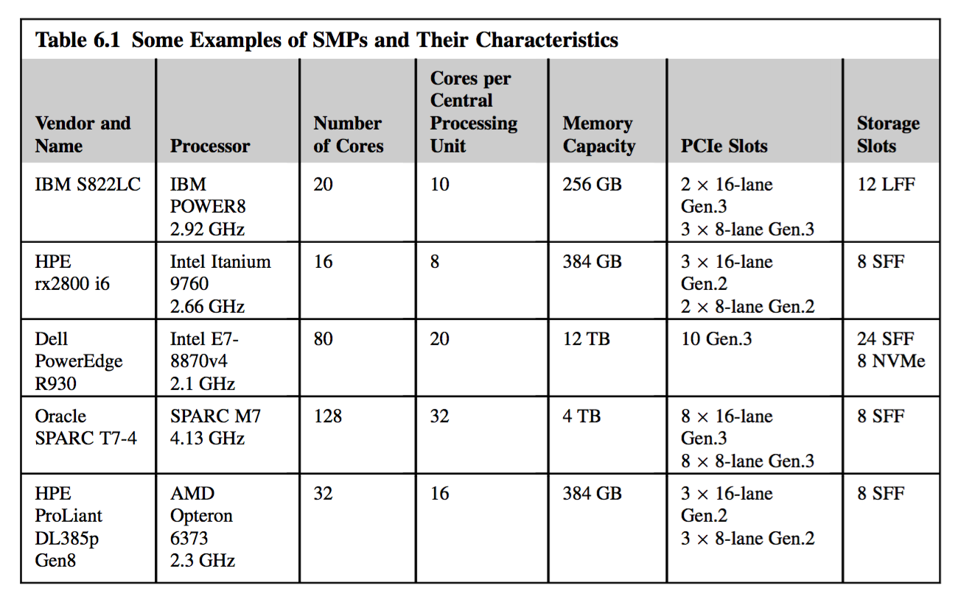

Slide 53
Topics
Introduction
SMP Context
Performance: Amdahl’s Law
SMP System structure
Processor core
Memory System
Chip set
South Bridge – I/O
Performance Issues

Slide 54



Performance: Amdahl’s Law
Baton Rouge to Houston
from my house on East Lakeshore Dr.
to downtown Hyatt Regency
distance of 271
in air flight time: 1 hour
door to door time to drive: 4.5 hours
cruise speed of Boeing 737: 600 mph
cruise speed of BMW 528: 60 mph

Slide 55
Amdahl’s Law: drive or fly?
Peak performance gain: 10X
BMW cruise approx. 60 MPH
Boeing 737 cruise approx. 600 MPH
Time door to door
BMW
Google estimates 4 hours 30 minutes
Boeing 737
Time to drive to BTR from my house = 15 minutes
Wait time at BTR = 1 hour
Taxi time at BTR = 5 minutes
Continental estimates BTR to IAH 1 hour
Taxi time at IAH = 15 minutes (assuming gate available)
Time to get bags at IAH = 25 minutes
Time to get rental car = 15 minutes
Time to drive to Hyatt Regency from IAH = 45 minutes
Total time = 4.0 hours
Sustained performance gain: 1.125X

Slide 56
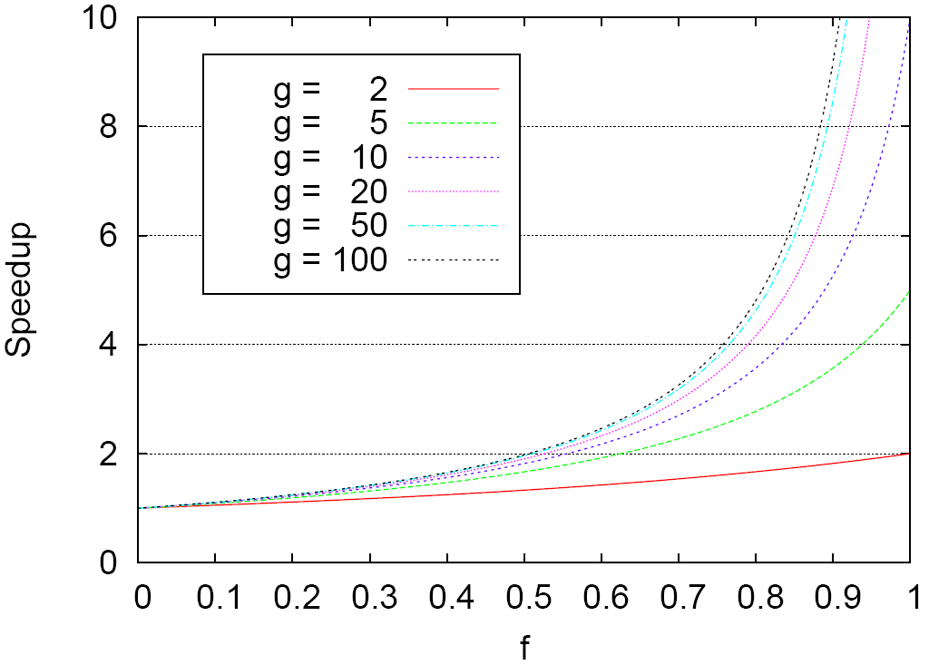
Amdahl’s Law
T_{O}
start
end
T_{A}
T_{F}
start
end
T_{F}/g

Slide 57
Amdahl’s Law with Overhead
T_{O}
start
end
t_{F}
t_{F}
t_{F}
t_{F}
T_{A}
start
end
v + t_{F}/g

Slide 58
Topics
Introduction
SMP Context
Performance: Amdahl’s Law
SMP System structure
Processor core
Memory System
Chip set
South Bridge – I/O
Performance Issues

Slide 59
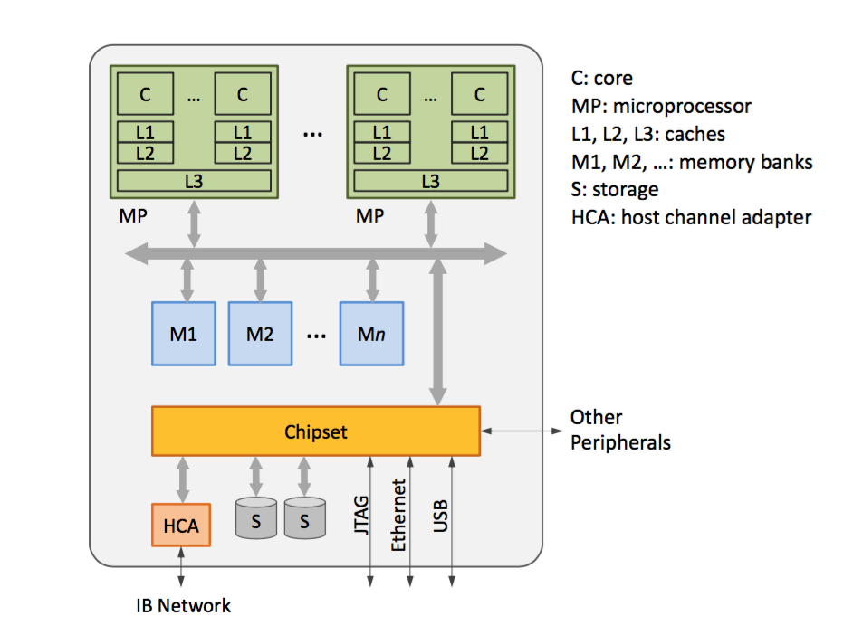
SMP Node Diagram

Slide 60
SMP System Examples

Slide 61
Major Elements of an SMP Node
Processor chip
DRAM main memory cards
Motherboard chip set
On-board memory network
North bridge
On-board I/O network
South bridge
PCI industry standard interfaces
PCI, PCI-X, PCI-express
System Area Network controllers
e.g. Ethernet, Myrinet, Infiniband, Quadrics, Federation Switch
System Management network
Usually Ethernet
JTAG for low level maintenance
Internal disk and disk controller
Peripheral interfaces

Slide 62
Topics
Introduction
SMP Context
Performance: Amdahl’s Law
SMP System structure
Processor core
Memory System
Chip set
South Bridge – I/O
Performance Issues

Slide 63
Multicore Microprocessor Component Elements
Multiple processor cores
One or more processors
L1 caches
Instruction cache
Data cache
L2 cache
Joint instruction/data cache
Dedicated to individual core processor
L3 cache
Not all systems
Shared among multiple cores
Often off die but in same package
Memory interface
Address translation and management (sometimes)
North bridge
I/O interface
South bridge

Slide 64
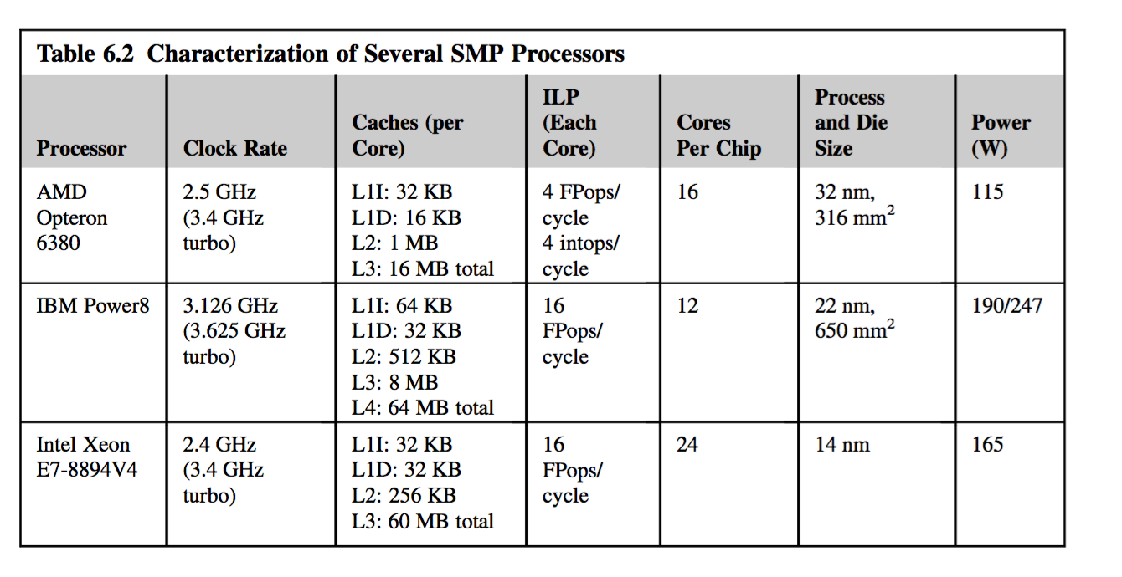
Comparison of Current Microprocessors

Slide 65
Processor Core Micro Architecture
Execution Pipeline
Stages of functionality to process issued instructions
Hazards are conflicts with continued execution
Forwarding supports closely associated operations exhibiting precedence constraints
Out of Order Execution
Uses reservation stations
hides some core latencies and provide fine grain asynchronous operation supporting concurrency
Branch Prediction
Permits computation to proceed at a conditional branch point prior to resolving predicate value
Overlaps follow-on computation with predicate resolution
Requires roll-back or equivalent to correct false guesses
Sometimes follows both paths, and several deep

Slide 66
Topics
Introduction
SMP Context
Performance: Amdahl’s Law
SMP System structure
Processor core
Memory System
Chip set
South Bridge – I/O
Performance Issues

Slide 67
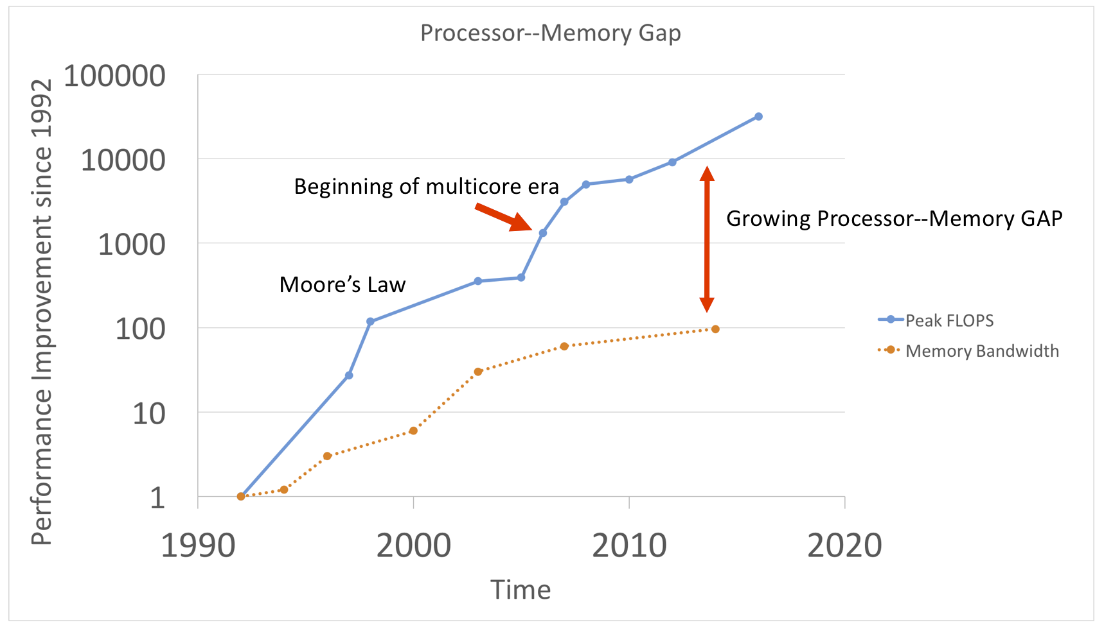
Recap: Who Cares About the Memory Hierarchy?
Processor-DRAM Memory Gap (latency)
Copyright 2001, UCB, David Patterson

Slide 68
What is a cache?
Small, fast storage used to improve average access time to slow memory.
Exploits spatial and temporal locality
In computer architecture, almost everything is a cache!
Registers: a cache on variables
First-level cache: a cache on second-level cache
Second-level cache: a cache on memory
Memory: a cache on disk (virtual memory)
TLB :a cache on page table
Branch-prediction: a cache on prediction information
Copyright 2001, UCB, David Patterson

Slide 69
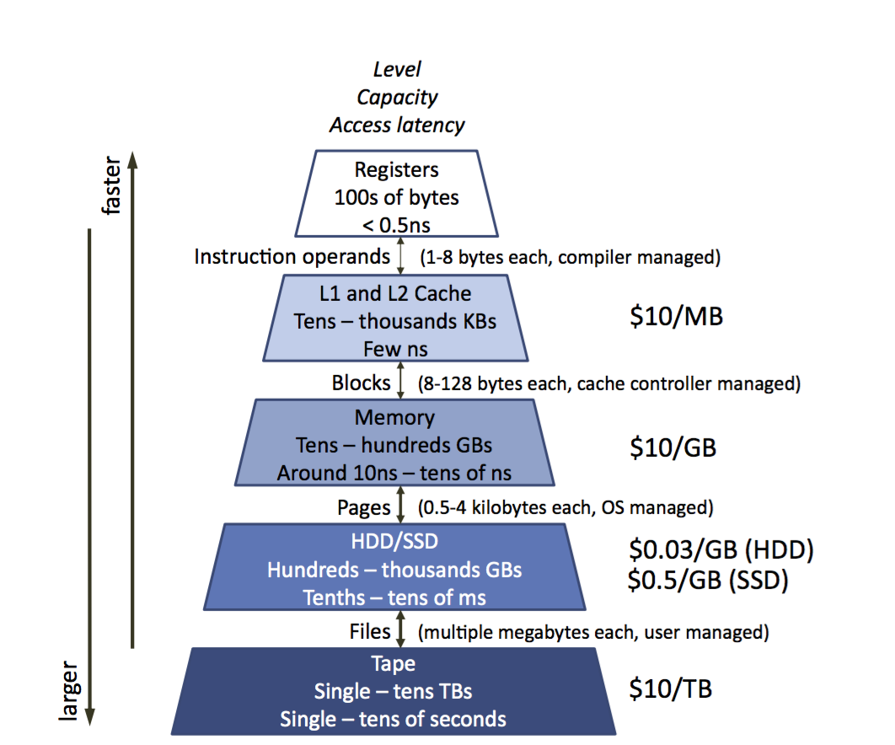

Slide 70
Cache Measures
Hit rate: fraction found in that level
So high that usually talk about Miss rate
Average memory-access time = Hit time + Miss rate x Miss penalty (ns or clocks)
Miss penalty: time to replace a block from lower level, including time to replace in CPU
access time: time to lower level
= f(latency to lower level)
transfer time: time to transfer block
=f(BW between upper & lower levels)

Slide 71
Memory Hierarchy: Terminology
Hit: data appears in some block in the upper level (example: Block X)
Hit Rate: the fraction of memory accesses found in the upper level
Hit Time: Time to access the upper level which consists of
RAM access time + Time to determine hit/miss
Miss: data needs to be retrieved from a block in the lower level (Block Y)
Miss Rate = 1 - (Hit Rate)
Miss Penalty: Time to replace a block in the upper level +
Time to deliver the block to the processor
Hit Time << Miss Penalty (500 instructions on 21264!)
Lower Level
Memory
To Processor
Upper Level
Memory
Blk X
From Processor
Blk Y
Copyright 2001, UCB, David Patterson

Slide 72
Cache Performance
T = total execution time
T_{cycle} = time for a single processor cycle
I_{count} = total number of instructions
I_{ALU} = number of ALU instructions (e.g. register – register)
I_{MEM} = number of memory access instructions ( e.g. load, store)
CPI = average cycles per instructions
CPI_{ALU} = average cycles per ALU instructions
CPI_{MEM} = average cycles per memory instruction
r_{miss} = cache miss rate
r_{hit} = cache hit rate
CPI_{MEM-MISS} = cycles per cache miss
CPI_{MEM-HIT}=cycles per cache hit
M_{ALU} = instruction mix for ALU instructions
M_{MEM} = instruction mix for memory access instruction

Slide 73
Cache Performance
T = total execution time
T_{cycle} = time for a single processor cycle
I_{count} = total number of instructions
I_{ALU} = number of ALU instructions (e.g. register – register)
I_{MEM} = number of memory access instructions ( e.g. load, store)
CPI = average cycles per instructions
CPI_{ALU} = average cycles per ALU instructions
CPI_{MEM} = average cycles per memory instruction
r_{miss} = cache miss rate
r_{hit} = cache hit rate
CPI_{MEM-MISS} = cycles per cache miss
CPI_{MEM-HIT}=cycles per cache hit
M_{ALU} = instruction mix for ALU instructions
M_{MEM} = instruction mix for memory access instruction

Slide 74
Cache Performance
T = total execution time
T_{cycle} = time for a single processor cycle
I_{count} = total number of instructions
I_{ALU} = number of ALU instructions (e.g. register – register)
I_{MEM} = number of memory access instructions ( e.g. load, store)
CPI = average cycles per instructions
CPI_{ALU} = average cycles per ALU instructions
CPI_{MEM} = average cycles per memory instruction
r_{miss} = cache miss rate
r_{hit} = cache hit rate
CPI_{MEM-MISS} = cycles per cache miss
CPI_{MEM-HIT}=cycles per cache hit
M_{ALU} = instruction mix for ALU instructions
M_{MEM} = instruction mix for memory access instruction

Slide 75
Cache Performance: Example

Slide 76
Sri Note on Cache
There are different caching strategies, both high and low level
At a high level strategies are things like Write through, read through etc.
Low level you have cache tradeoffs between search/hit rate – basically you can use a regular cache system (direct mapped) which is easier to implement and faster to access, or associative, which searches for the object in cache, but is more likely to have it there.

Slide 77
Topics
Introduction
SMP Context
Performance: Amdahl’s Law
SMP System structure
Processor core
Memory System
Chip set
South Bridge – I/O
Performance Issues

Slide 78
Motherboard Chipset
Provides core functionality of motherboard
Embeds low-level protocols to facilitate efficient communication between local components of computer system
Controls the flow of data between the CPU, system memory, on-board peripheral devices, expansion interfaces and I/O susbsystem
Also responsible for power management features, retention of non-volatile configuration data and real-time measurement
Typically consists of:
Northbridge (Memory Controller Hub, MCH), managing traffic between the processor, RAM, GPU, southbridge and optionally PCI Express slots
Southbridge (I/O Controller Hub, ICH), coordinating slower set of devices, including traditional PCI bus, ISA bus, SMBus, IDE (ATA), DMA and interrupt controllers, real-time clock, BIOS memory, ACPI power management, LPC bridge (providing fan control, floppy disk, keyboard, mouse, MIDI interfaces, etc.), and optionally Ethernet, USB, IEEE1394, audio codecs and RAID interface

Slide 79
Major Chipset Vendors
Intel
http://developer.intel.com/products/chipsets/index.htm
Via
http://www.via.com.tw/en/products/chipsets
SiS
http://www.sis.com/products/product_000001.htm
AMD/ATI
http://ati.amd.com/products/integrated.html
Nvidia
http://www.nvidia.com/page/mobo.html

Slide 80
Motherboard
Also referred to as main board, system board, backplane
Provides mechanical and electrical support for pluggable components of a computer system
Constitutes the central circuitry of a computer, distributing power and clock signals to target devices, and implementing communication backplane for data exchanges between them
Defines expansion possibilities of a computer system through slots accommodating special purpose cards, memory modules, processor(s) and I/O ports
Available in many form factors and with various capabilities to match particular system needs, housing capacity and cost

Slide 81
Motherboard Form Factors
Refer to standardized motherboard sizes
Most popular form factor used today is ATX, evolved from now obsolete AT (Advanced Technology) format
Examples of other common form factors:
MicroATX, miniaturized version of ATX
WTX, large form factor designated for use in high power workstations/servers featuring multiple processors
Mini-ITX, designed for use in thin clients
PC/104 and ETX, used in embedded systems and single board computers
BTX (Balanced Technology Extended), introduced by Intel as a possible successor to ATX

Slide 82
Motherboard Manufacturers
Abit
Albatron
Aopen
ASUS
Biostar
DFI
ECS
Epox
FIC
Foxconn
Gigabyte
IBM
Intel
Jetway
MSI
Shuttle
Soyo
SuperMicro
Tyan
VIA

Slide 83
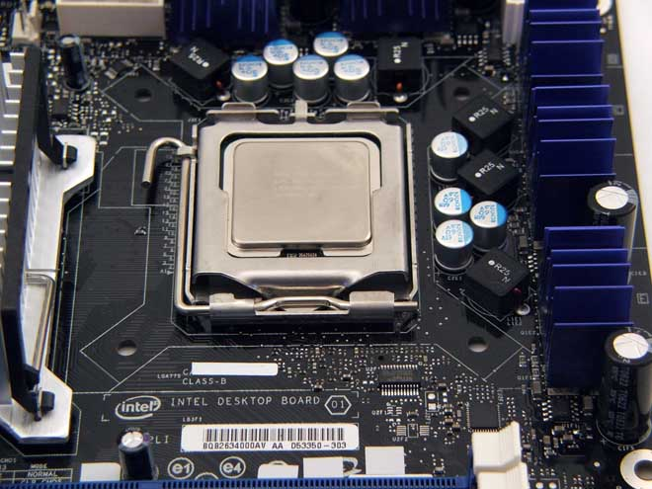
Populated CPU Socket
Source: http://www.motherboards.org

Slide 84
Topics
Introduction
SMP Context
Performance: Amdahl’s Law
SMP System structure
Processor core
Memory System
Chip set
South Bridge – I/O
Performance Issues

Slide 85
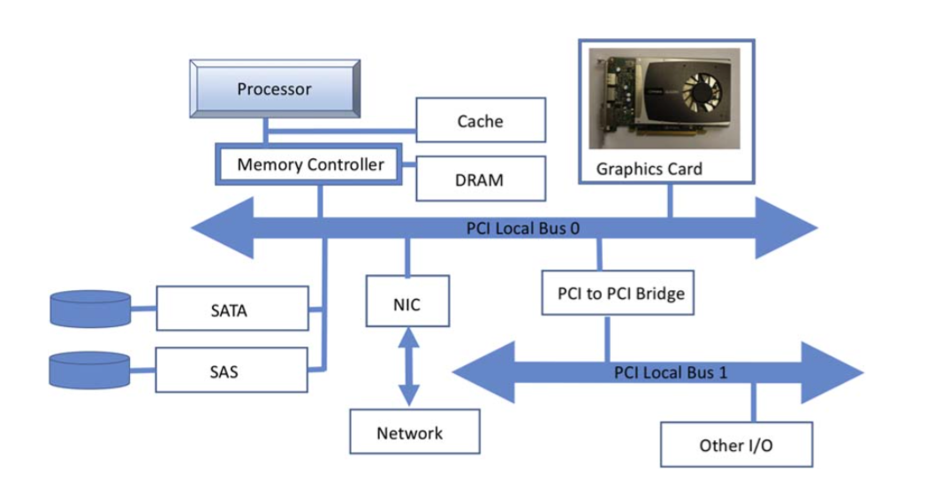
Layout of system equipped with multiple PCI buses

Slide 86
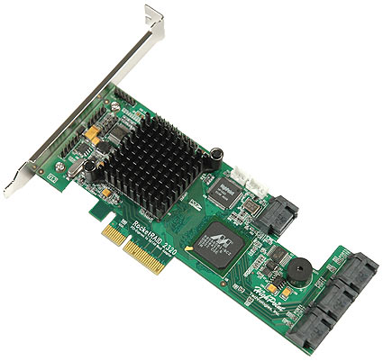
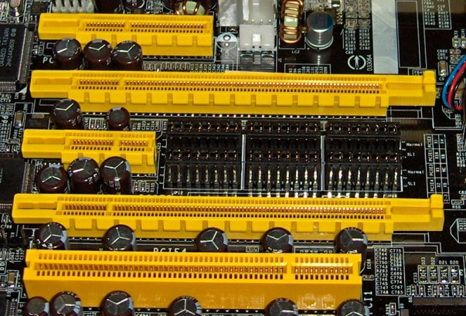
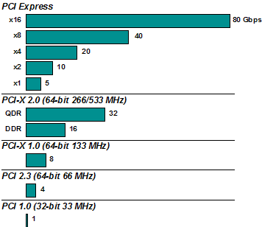
PCI-express
Lane width | Clock speed | Throughput (duplex, bits) | Throughput (duplex, bytes) | Initial expected uses
x1 | 2.5 GHz | 5 Gbps | 400 MBps | Slots, Gigabit Ethernet
x2 | 2.5 GHz | 10 Gbps | 800 MBps
x4 | 2.5 GHz | 20 Gbps | 1.6 GBps | Slots, 10 Gigabit Ethernet, SCSI, SAS
x8 | 2.5 GHz | 40 Gbps | 3.2 GBps
x16 | 2.5 GHz | 80 Gbps | 6.4 GBps | Graphics adapters
Version 5(2019) has an x16 speed of 63GB/s, version 6 (planned for 2021) has 126.03GB/s planned at x16
(divide by 2 for full duplex)

Slide 87
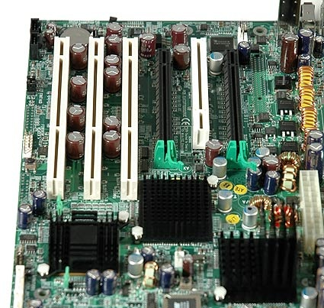
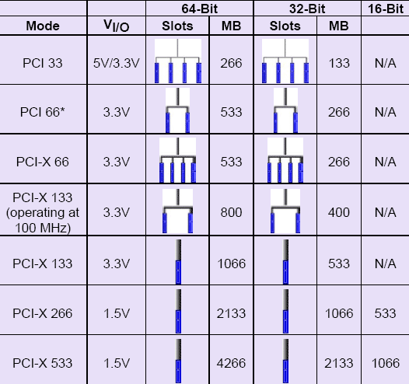
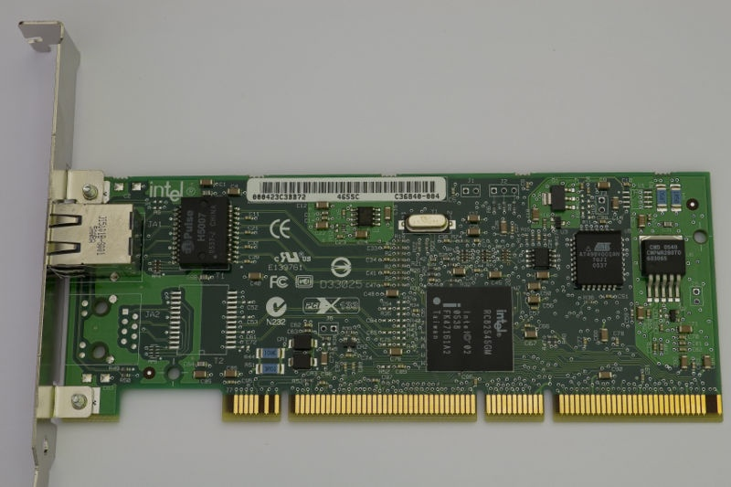
PCI-X (replaced in 2004 by PCI express, previous slide)
 | Bus Width | Clock Speed | Features | Bandwidth
PCI-X 66 | 64 Bits | 66 MHz | Hot Plugging, 3.3 V | 533 MB/s
PCI-X 133 | 64 Bits | 133 MHz | Hot Plugging, 3.3 V | 1.06 GB/s
PCI-X 266 | 64 Bits, optional 16 Bits only | 133 MHz Double Data Rate | Hot Plugging, 3.3 & 1.5 V, ECC supported | 2.13 GB/s
PCI-X 533 | 64 Bits, optional 16 Bits only | 133 MHz Quad Data Rate | Hot Plugging, 3.3 & 1.5 V, ECC supported | 4.26 GB/s

Slide 88
Bandwidth Comparisons
CONNECTION | BITS | BYTES
PCI 32-bit/33 MHz | 1.06666 Gbit/s | 133.33 MB/s
PCI 64-bit/33 MHz | 2.13333 Gbit/s | 266.66 MB/s
PCI 32-bit/66 MHz | 2.13333 Gbit/s | 266.66 MB/s
PCI 64-bit/66 MHz | 4.26666 Gbit/s | 533.33 MB/s
PCI 64-bit/100 MHz | 6.39999 Gbit/s | 799.99 MB/s
PCI Express (x1 link)^{[6]} | 2.5 Gbit/s | 250 MB/s
PCI Express (x4 link)^{[6]} | 10 Gbit/s | 1 GB/s
PCI Express (x8 link)^{[6]} | 20 Gbit/s | 2 GB/s
PCI Express (x16 link)^{[6]} | 40 Gbit/s | 4 GB/s
PCI Express 2.0 (x32 link)^{[6]} | 80 Gbit/s | 8 GB/s
PCI-X DDR 16-bit | 4.26666 Gbit/s | 533.33 MB/s
PCI-X 133 | 8.53333 Gbit/s | 1.06666 GB/s
PCI-X QDR 16-bit | 8.53333 Gbit/s | 1.06666 GB/s
PCI-X DDR | 17.066 Gbit/s | 2.133 GB/s
PCI-X QDR | 34.133 Gbit/s | 4.266 GB/s
AGP 8x | 17.066 Gbit/s | 2.133 GB/s

Slide 89
Sri note
With Multi GPU systems (or multi accelerator systems) PCIx bandwidth can be a major constraint.
Basically PCIx is divided up into ‘lanes’ (64, 32, 16, 8 etc) which scale bandwidth linearly.
Each gpu gets a slot but not all slots can have all possible lanes at full speed necessarily
So some GPU’s get reduced bandwidth.

Slide 90
E.g.
Ryzen 3960x and 3970x have 88 PCIe (v4.0) lanes, which is enough for 5.5 GPUs…
(you’d do probably 4 GPUs and some memory devices)
The 3950x… has 24. So 1 GPU + other stuff.
You can run GPU’s on fewer PCIe lanes, and for gaming that’s usually fine (albeit sometimes increasing load times) but for HPC that memory bandwidth usually matters more.

Slide 91
Topics
Introduction
SMP Context
Performance: Amdahl’s Law
SMP System structure
Processor core
Memory System
Chip set
South Bridge – I/O
Performance Issues

Slide 92
Performance Issues
Cache behavior
Hit/miss rate
Replacement strategies
Prefetching
Clock rate
ILP
Branch prediction
Memory
Access time
Bandwidth

